Slide 1







Smartphone based Urine Testing Devices

Slide 2


Why we need them?
As technology and the world of AI and ML advance, we must integrate these into our most basic healthcare facilities. Given our GDP's percentage in the healthcare sector, it is critical to develop affordable and accurate smartphone-based devices to save lives and improve people's overall standard of living.
The majority of the population does not have access to the internet or a phone, so as we move forward, we must focus on making it available to the bulk of the population.
The journey will be tough but we are ready to go.

Slide 3

Let’s go and look at current work

Slide 4
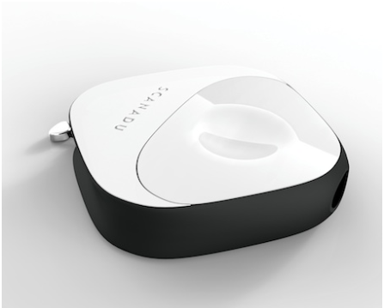
Scanadu, Inc.-inui In-Home Urine Analysis Test System
Measurand: Glucose, protein, leukocyte, nitrite and ketones in urine
Qualitative and semi-quantitative urinalysis
The test results provide information regarding the status of urinary tract infections (UTI), proteinuria, glucosuria, and ketonuria. These results can be used as an aid for monitoring kidney functions, metabolic disorders (e.g. diabetes mellitus), and can be used in the screening for urinary tract infections (UTI).
Cost<$150

Slide 5
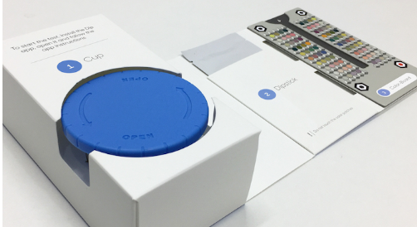
Healthy.io-smartphone camera-based home urine test
The kit contains detailed instructions for home testing and disposable test strips and testing cups.
Major innovation is a panel of patterns and colors that allows the smartphone camera to accurately read the test strip regardless of lighting or environment.
AI based image processing has been utilized.
Patients don't have to mail anything back, and they can get results right away.
Test results are around 90-100% accurate with overall efficiency of around 93%.

Slide 6
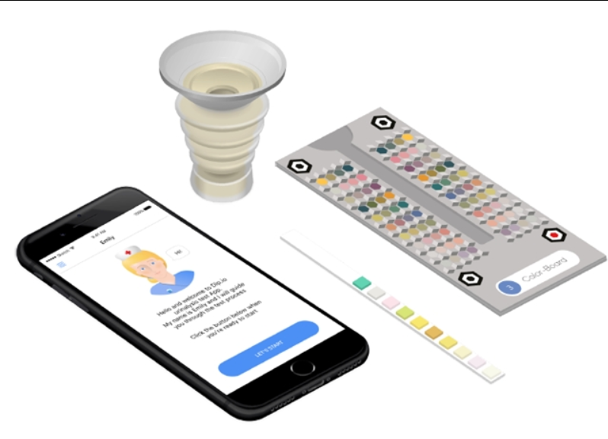
The Dip.io urinalysis test system from Israeli-based Healthy.io
The test is for the semi-quantitative detection of glucose, specific gravity, blood, pH and protein, as well as the qualitative detection of nitrite
Test for ketones , leukocytes, nitrites, glucose, protein, blood, specific gravity, bilirubin, urobilinogen, and pH
These indicators span a wide range of pathologies, from urinary tract infection to ketosis, kidney disease, health in pregnancy, and bladder cancer.”
96 percent of participants who attempted the Dip.io test were successful; two-thirds preferred at-home testing

Slide 7

Healthy fact!

Slide 8
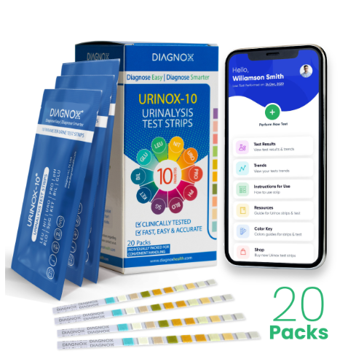

Diagnox-urinox-10 urinalysis test strips
Multi-Parameter Urine Test Strip for Urinary Tract Infection UTI
Analyze urine for most critical parameters PRO, pH, LEU, NIT, SG, BIL & more
Urinary Tract Infection (UTI), Liver, Kidney & Gallbladder Test
Test is easy to use and delivers results within 2 minutes with clinical-grade accuracy.
Camera is used for image processing and providing feedback.
Price=2890

Slide 9
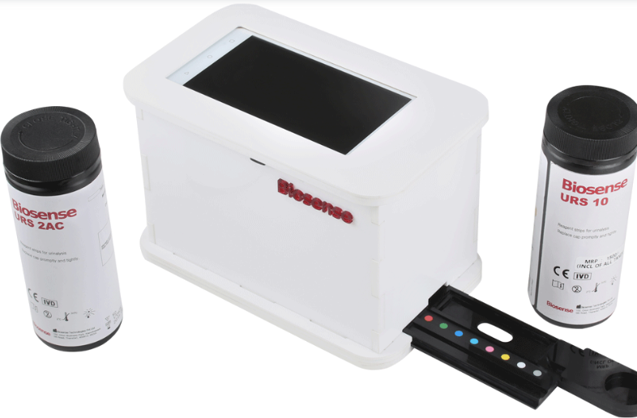



Biosense-uCheck
Smart phone based portable diagnostic system which measures micro albumin to creatine ratio and multi parameters of routine urine.
Urine analysis system takes images at predetermined time intervals to detect colour changes in urine strip parameter pad and give highly accurate results.
uChek device uses Image based CCD array sensor which has 10,000 sensors built in it. With standard internal lighting and box, uChek’s color differentiation and recognition becomes far superior than these analyzers.
Overall accuracy is 91% with Sensitivity of 90% and Specificity of 92%.

Slide 10
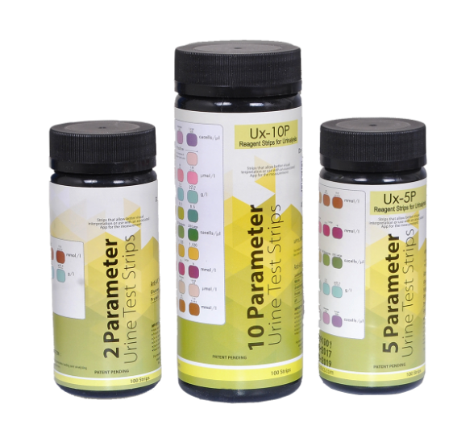

Spark Diagnostics Urinalysis Reagent Strips with Mobile Reader
No visual reading required. Use the free app to scan the strip for testing and get the readings
The app indicates if the values are in appropriate range for urine strip
Measure Protein, Glucose in Urine upto 10 parameters
result should be read within 1 min
Uses camera for image processing
Accuracy in test varies from 80-100% overall accuracy is around 90%.

Slide 11

Healthy fact!

Slide 12




Vivoo 2.0 | Advanced Urine Test Strips with App
Provides detailed information and easy to understand results about your wellbeing. enough water? ,Is your urine acidic or alkaline? Etc.
Analyzes urine & provides nutrition & lifestyle advice, unique to your results in 90 seconds
Measures 9 key wellness parameters
It is again a camera based setup which uses image processing to get the results.
Costs around 10$ per test.

Slide 13
Here are few works which are almost on commercial phase

Slide 14
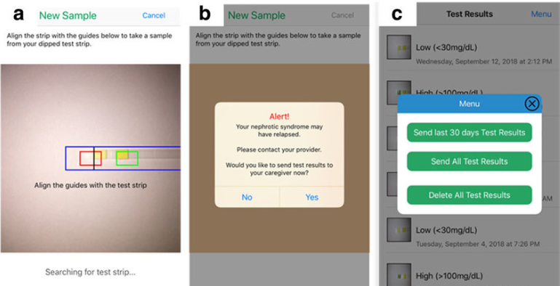

UrApp – Nephrotic Syndrome Manager, to aid disease monitoring.
Accurate and fast camera-read of urine test strips reduces care burden and minimize errors.
Early identification of disease relapses and remissions provides timely alerts and action plans.
Provides clear documentation of urine protein results and intuitive results display.
Educational materials prepared by nephrotic syndrome experts

Slide 15
Smartphone-Based Urine Reagent Strip Test in the Emergency Department
Developed for a rapid and accurate screening of leukocyte esterase (LE) and nitrite (NIT) in urine..
The detection performance of the reader for LE and NIT was evaluated to assess reliability of the reader; turnaround times (TATs) for analysis and the time for the entire study procedure were also calculated to assess the efficiency of the reader
A photometric analyzer (model US-3100R Plus(®); Eiken Chemical, Ltd., Tokyo, Japan) was used as a reference.
The proposed reader showed high accuracy (85.2% for LE and 97.5% for NIT), exhibiting close agreement with the true values (κ = 0.903 for LE; κ = 1.000 for NIT)

Slide 16
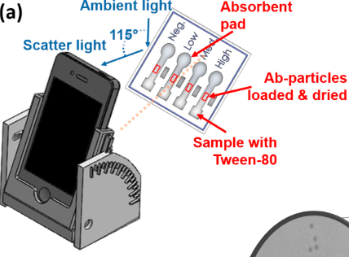
Smartphone-based, sensitive µPAD detection of urinary tract infection and gonorrhea
Developed to monitor the onset or prognosis of urinary tract infection (UTI) and some sexually-transmitted diseases (STDs), such as gonorrhea through bacteria.
A microfluidic paper analytical device (µPAD) was designed and fabricated for evaluating UTI (E. coli) and STD.
Antibody-conjugated particles were immunoagglutinated at the center of the paper channel. The extent of immunoagglutination was quantified by angle-specific Mie scatter under ambient lighting conditions, utilizing a smartphone camera as a detector
The total μPAD assay time was less than 30s.
The proposed prototype will serve as a low-cost, point-of-care, sensitive urinalysis biosensor to monitor UTI and gonorrhea from human urine.

Slide 17
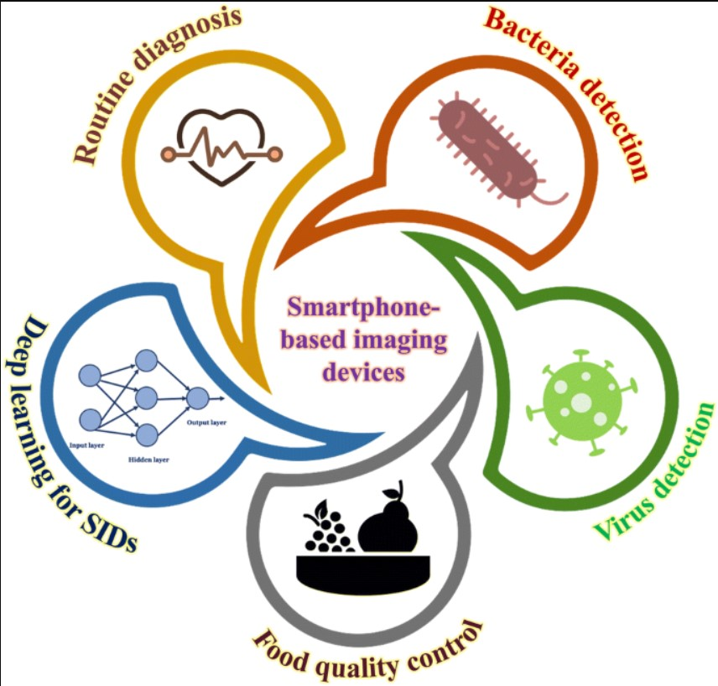
Conclusion:
Following chart organizes the techniques utilized overall it mostly depends upon various testing parameters and then finally image processing to get the result.

Slide 18

Remember… Safety First!
(Enter your own creative tag line above)

